Slide 1
O365 Buy and Try intent

Slide 2
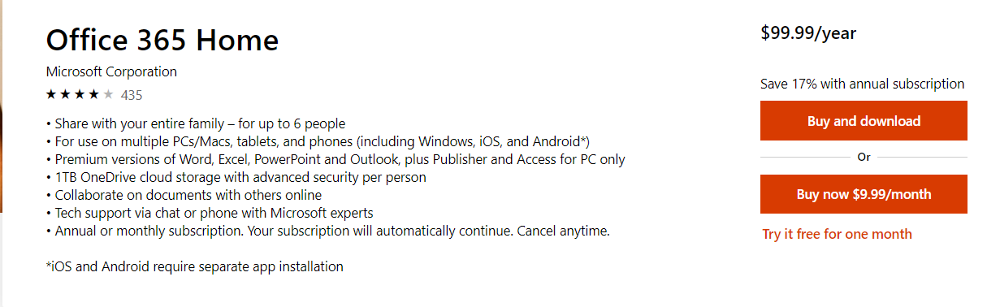
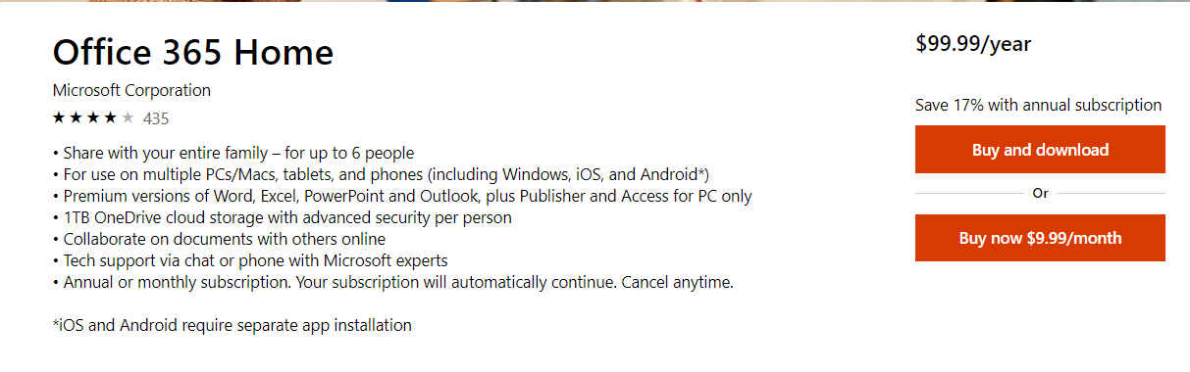
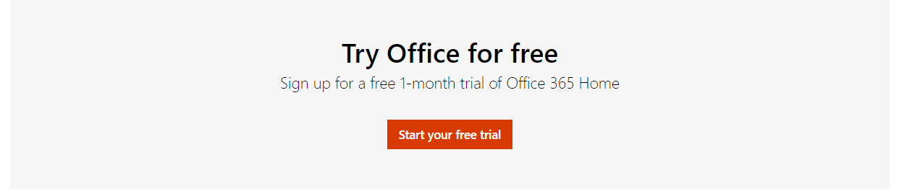
Test Overview
Control – with Trial link
Goal | Increase Office Order rate
Hypothesis | If we removed the free trial link from the O365 Home and Personal Buy Box, but placed it at the bottom of the page as well as in a pop-up modal if user is leaving the page/closing the browser, then Office order rate will increase because customers will opt to order immediately instead, and mitigate the potential overall Trial abandonment from removing the Trial altogether. .
Test Page URL(s) | Office 365 Home & Personal PDPs:
Markets | EN-US, EN-CA
Test Dates | 5/22/2019 – 6/10/2019
KPIs | Primary KPI: Office Orders; Secondary KPI: Office Funnel
Minimum Detectable Effect (MDE) | 3%
Channels | Desktop, Tablet, Mobile
VSO Ticket # | 21560219
Variant – Moved Trial link to page bottom

Slide 3
Want to understand user intent when they come to PDP. Are they more ready to buy (and the trial link was a distraction so that they didn't buy right away) or were they not apt to buy and trial was a good offer?
Q – Buy and try user characteristics based on historical data. If a user matches buy traits, then ready to BUY. If a user matches, TRY traits the ready to TRY. Capture buy and try rate. [Slide 4]
Context
If we have more people that are ready to buy, for example, then moving trial lower on page might actually be a good thing to increase Orders.
Q– during test period, did the user base for BUY traits increased ? Compare with historical data. [ slide 5]
But if we can figure out if users are more in browsing and not ready to buy, that this group may have converted on Trial more - but now that we moved it and made it less visible, it was a bad thing.
Q- during test period did TRY’s user base increase ? [slide 6]
Impact
Science
Gathered Pre-test period data for 1 month
Test Period data from Treatment flight (i.e. Variant with Trial link at the bottom of the page)
O365 home and Personal PDP
US Market
Source: Adobe/EXP/Clicktale

Slide 4

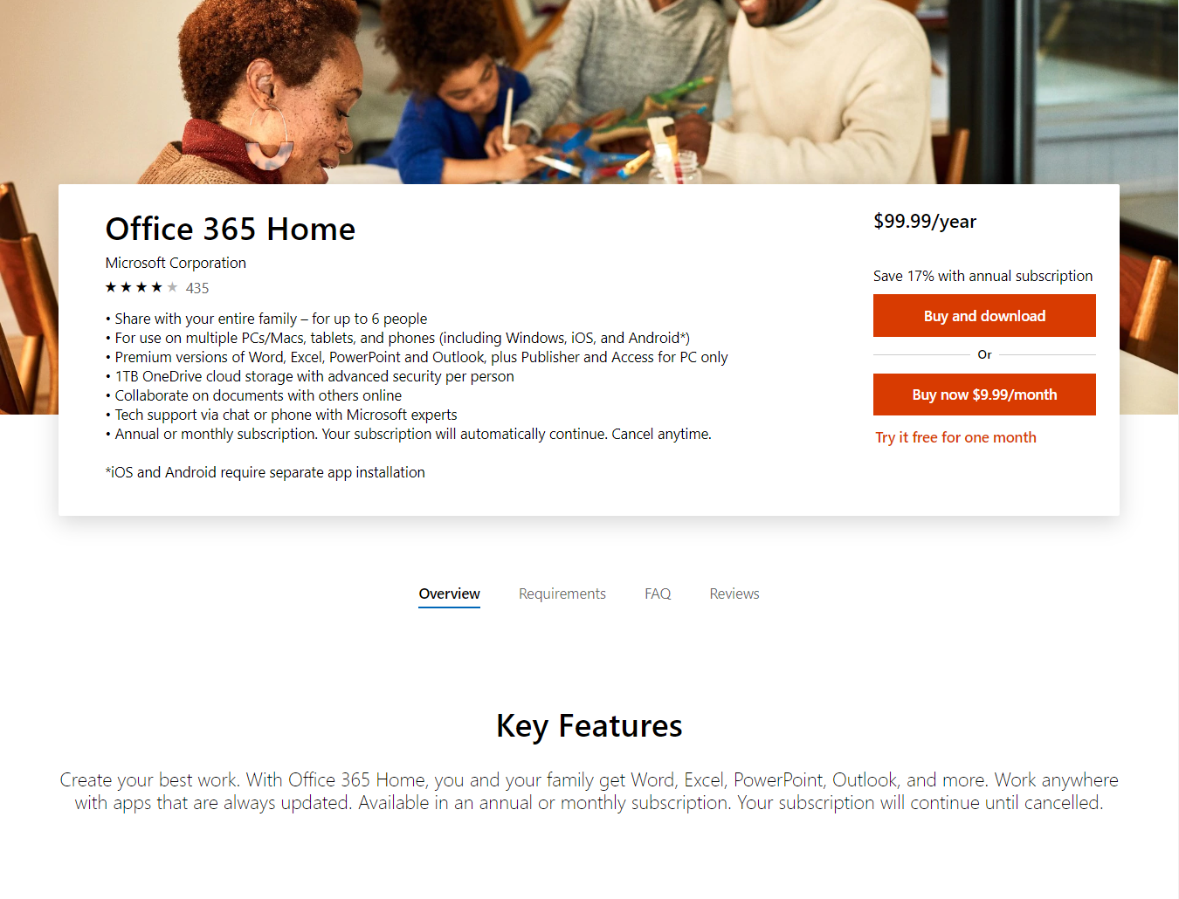


Customer behavior features for O365 Buys and Trys
O&O
Direct
Organic Search
Traffic Channel
Office.com
Store
O365 Web
Entry Domain
New Visitor
Return Visitor

Slide 5
Summary
During the test Buy rate decreased vs. Pre-test
Trials in pre-test did not shifted to buys in test period for O365 home
For O365 personal users from Store and Paid search did shift from Trials to Buys but not enough to increase the overall buy rate
Source: Adobe/EXP/Clicktale
Notes:
Questions addressed – did the test moved users who intended to ‘Try’ to ‘Buy’ ?
For test period (Treatment data was considered)

Slide 6
O365 Home PDP

Slide 7
O365 Home – User Features with Buy-Try Intent (Pre-Test Period)
Return visitors
Enter PDP from Office.com
Traffic Channel – Direct or O&O
Tabs Engaged – FAQ, Review
Try Intent
Buy Intent
New visitors
Enter PDP from Store or O365 Web
Traffic Channel – Paid Search or Organic Search
Tabs Engaged – TechSpecs, Overview
Source: Adobe/EXP/Clicktale
Notes:
For users who placed buy or Try orders, what is the rate for all the features
1 month time period

Slide 8
O365 Home – Test Period ‘Buys’ decreased vs. Pre-Test ‘Buys’
Test had significantly less users ready to ‘Buy’ vs. Pre-test by -9.2%. (decreasing trends)
Enter PDP from Office.com (-13.9%)
Traffic Channel Direct (-8.7%)
Also dropped on other traits vs, pre-test
However it increased ‘Buy’ user base for below (increasing trends)
Return Visitors +7.1%
Traffic Channel – O&O +13.8%
Tabs engaged – FAQ(+38.5%) and Review (+2.5%)
Source: Adobe/EXP/Clicktale
Notes:
1. Questions addressed – did the test moved users who intended to ‘Try’ to ‘Buy’ ?
2. For test period (Treatment data was considered)
3. For #1 Buy traits were considered for drop as other classify for Trys
4. For #2 Buy traits are considered to dig into if that user base has increased during the Test.

Slide 9
O365 Home – Pre-test ‘Trys’ loss in Test-period ‘Buys’
Below users were ‘Try’ing in pre-test period but lost in Treatment ‘buys’. So below were in browsing mode which tried in Pre-test. However by shifting the link to the bottom of the page, they failed to convert (Trials subscription).
Enter from Store (-8.3%,) O365 web -23.3%
Traffic Channel – Paid (-25.3%) , Organic Search (-34.7%)
Saw overview Tab - (-11%)
Source: Adobe/EXP/Clicktale
Notes:
Questions addressed – did the test moved users who intended to ‘Try’ to ‘Buy’ ?
For test period (Treatment data was considered)

Slide 10
O365 Personal PDP

Slide 11
O365 Personal – User Features with Buy-Try Intent (Pre-Test Period)
Return visitors
Traffic Channel – Direct or O&O
Tabs Engaged – Overview
Try Intent
Buy Intent
New visitors
Traffic Channel – Paid Search or Organic Search
Tabs Engaged – TechSpecs, FAQ, Reviews
** Enter PDP from anywhere ( Store, O365 Web, Office.com)
Source: Adobe/EXP/Clicktale
Notes:
For users who placed buy or Try orders, what is the rate for all the features
1 month time period

Slide 12
O365 Personal – Test Period ‘Buys’ decreased vs. Pre-Test
Test had significantly less users ready to ‘Buy’ vs. Pre-test ‘Buys’ by -27.3%. (decreasing trends)
Traffic Channel Direct (-15%)
Also dropped for other features vs. pre-test
However it increased ‘Buy’ user base for below (increasing trends)
Return Visitors +9.9%
Traffic Channel – O&O +20.3%
Tabs engaged Overview – +427%
Test has more ‘Return’ visitors 7.1%
Test had more visitors from O&O 13.8%
Test moved users engaging ‘FAQ’ and Review 38.5%, 2.5%
Source: Adobe/EXP/Clicktale
Notes:
1. Questions addressed – did the test moved users who intended to ‘Try’ to ‘Buy’ ?
2. For test period (Treatment data was considered)
3. For #1 Buy traits were considered for drop as other classify for Trys
4. For #2 Buy traits are considered to dig into if that user base has increased during the Test.

Slide 13
O365 Home – Test Period ‘Buys’ shifts ‘Trys’ from pre-Test
Test also shifted users with ‘Try’ traits to ‘Buys’ for below traits:
Enter from Store +23.5%
Enter from ‘Paid Search’ +1.2%
Engage with tabs, all except Overview (but volume is low)
Test moved users engaging ‘TechSpecs’ who intened to ‘Try’ towards ‘Buy’ by +23.4%
Test moved users entering from ‘Paid Search’ to who intended to ‘Try’ towards ‘Buy’ by +13%
Test moved users entering from Store to who intended to ‘Try’ towards ‘Buy’ by +21%
Source: Adobe/EXP/Clicktale
Notes:
Questions addressed – did the test moved users who intended to ‘Try’ to ‘Buy’ ?
For test period (Treatment data was considered)

Slide 14
O365 Home – Trys loss in test-period Buys
Below users were ‘Try’ing in pre-test period but lost in Treatment ‘buys’. So below were in browsing mode which tried in Pre-test. However by shifting the link to the bottom of the page, they failed to convert (Trials subscription).
New Visitors (-4.4%)
Enter from o365 web (-37.6%) and Office.com (-40.2%)
Organic Search (-42.9%)
Source: Adobe/EXP/Clicktale
Notes:
Questions addressed – did the test moved users who intended to ‘Try’ to ‘Buy’ ?
For test period (Treatment data was considered)

Slide 15
Appendix

Slide 16
O365 Home –‘Trys’ from pre-Test shifted to Test Period ‘Buys’
Test also shifted users with ‘Try’ traits to ‘Buys’ for below traits:
Enter from Store +21%
Enter from ‘Paid Search’ +13%
Engage with Tech Specs +23.4%
Test moved users entering from Store to who intended to ‘Try’ towards ‘Buy’ by +21%
Test moved users entering from ‘Paid Search’ to who intended to ‘Try’ towards ‘Buy’ by +13%
Test moved users engaging ‘TechSpecs’ who intended to ‘Try’ towards ‘Buy’ by +23.4%
Source: Adobe/EXP/Clicktale
Notes:
Questions addressed – did the test moved users who intended to ‘Try’ to ‘Buy’ ?
For test period (Treatment data was considered)

